Slide 1

Advancing the Medicaid IT Enterprise Project
CMS ALLIANCE TO MODERNIZE HEALTHCARE
Reference Architecture Working Group – June 9, 2017

Slide 2
Agenda
MITA Governance Board
MESC Conference
VT presentation on the Language of Architecture
RedHat OpenShift
Name for Reference Architecture
Next week

Slide 3
Language of Architecture
Andrew Laing, Vermont

Slide 4
RedHat OpenShift
Functionality
Enterprise container deployment platform
Based on Docker, popular container software
Based on Kubernetes (Google), open source container orchestration software
Automated build and deploy Docker-formatted containers
Includes a web console and OAuth 2 authentication server
Ties in with contiguous integration and contiguous deployment tools
Several pre-built container environments
.NET, Java, Node.js, PHP, Python, Ruby, Perl, Tomcat
MariaDB, MongoDB, MySQL, PostgreSQL, Redis
Service registration /discovery can be done through Kubernetes labels

Slide 5
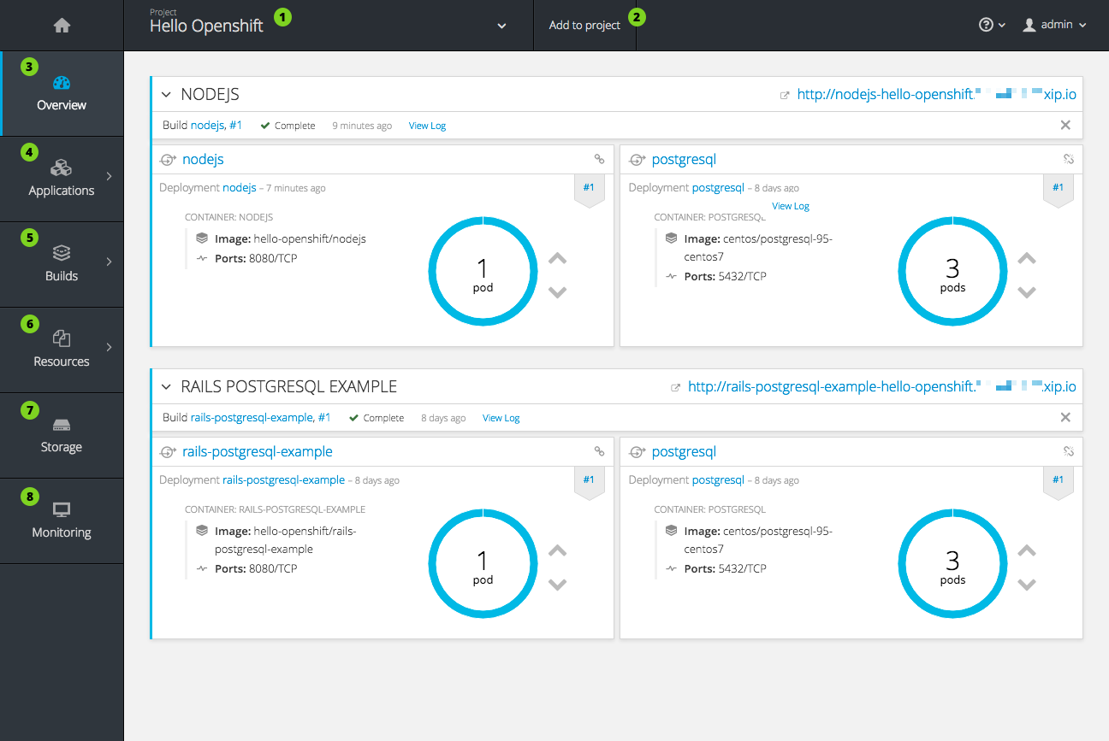

Slide 6
RedHat OpenShift – Community / Customers

Slide 7
RedHat OpenShift
Performance
Based on Go
Docker and Kubernetes have performed well in large-scale environments
Scalability
Google wrote Kubernetes and use it in their framework
Security
MITRE has seen some issues working with third party Docker-based security tools
Interoperability
Compatibility issues with some third-party Docker-based tools
Reliability
Docker and Kubernetes have performed well in large-scale environments

Slide 8
RedHat OpenShift
Strength of Community
Bug tracker activity Hourly, 1138 open, 4559 closed
Commit diversity and rate 239 contributors, 19K commits
Community size 260 companies and organizations
Organizational diversity 260 companies and organizations
Activity in discussion forums Hourly
Activity in new, announcements, and releases 8906 OpenShift projects in GitHub
Longevity 74 releases since 9/2014

Slide 9
RedHat OpenShift
Technology and Standards Linux, Go, Angular.js, Docker (modified), Kubernetes (included)
Licensing Apache 2.0
Pros
Adds enterprise deployment framework on top of established open source tools like Kubernetes and Docker
Large, active community
RedHat is an established open source player
Cons
OpenShift Container Platform (OCP) makes significant changes to Docker
Other Docker-related support software may not work
Support for OCP is improving from tool vendors, but is not yet widespread

Slide 10
Reference Architecture Names
Some examples:
Radius
Trellis (structure)
Wicker (structure)
Acacia (tree)
Tupelo (tree)
Coral
AMIE – Advanced Medicaid Integration Environment
Hermes (god of transitions and boundaries)

Slide 11
Next Meeting
Open source software evaluations and recommendations

Slide 12
Potential Open Source Components (Evaluation Leads)
Platform as a Service (MITRE)
RedHat OpenShift
Communication / Messaging (CNSI)
Apache Kafka, RabbitMQ
Registration / Discovery
Consul, Hyperbahn, ZooKeeper
Load Balancing
AWS Elastic Load Balancer, Netflix Eureka, HAProxy, Nginx
Security (MITRE, CNSI – SAML, experience with states)
Heart Working Group, Argonauts, OAuth2, OpenID Connect, User Managed Access (UMA, Kantara), SAML
OpenStack

Slide 13
Evaluating Open Source Software
Functionality
Performance, Scalability, Security, Interoperability, Reliability
Strength of Community
Bug tracker activity
Commit diversity and rate
Community size
Organizational diversity
Activity in discussion forums
Activity in new, announcements, and releases
Longevity
Technology and Standards
Licensing
Market Share / Customers
This information will be captured by category for decision making

